Slide 1


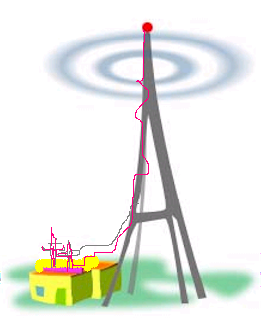

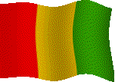




VISION FOR A RADIO STATION for Three Countries
Broadcasting
from FOYA to
Kissi speaking people
Gueckedou
Guinea
Kissi speaking people
Kissi speaking people
Foya
Kunadun
Sierra Leone
Liberia

Slide 2
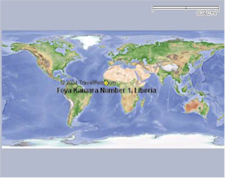
Where is Foya on the world map?
Foya is a bordering town between three countries:
Guinea
Sierra Leone
Liberia
Foya Kamala

Slide 3
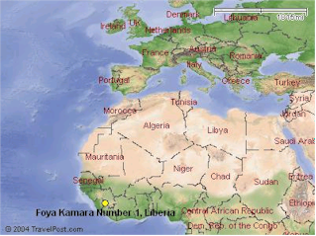
Language spoken in Foya
Kissi, this language is spoken in
the three bordering towns.
Foya Kamala

Slide 4
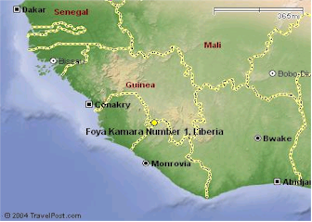
Common language of communication is the kissi
Guinea
Sierra Leone
Foya Kamala

Slide 5
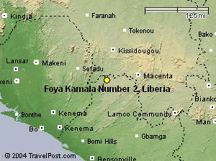
Radio Coverage
Guinea
Sierra Leone
Foya Kamala

Slide 6
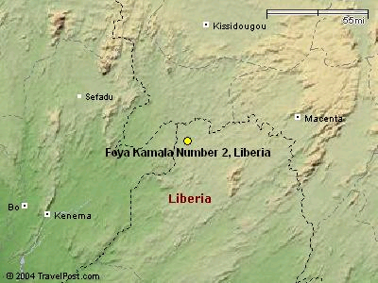
Guinea
Sierra Leone
Foya Kamala

Slide 7
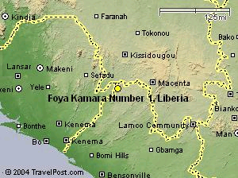
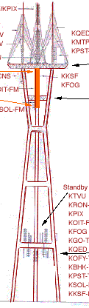

Slide 8
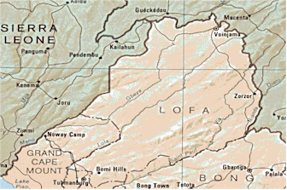
Foya Kamala
Notes:
Foya Kuandun

